Slide 1
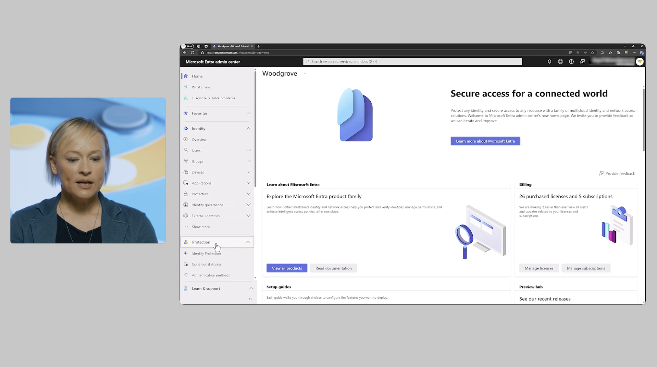
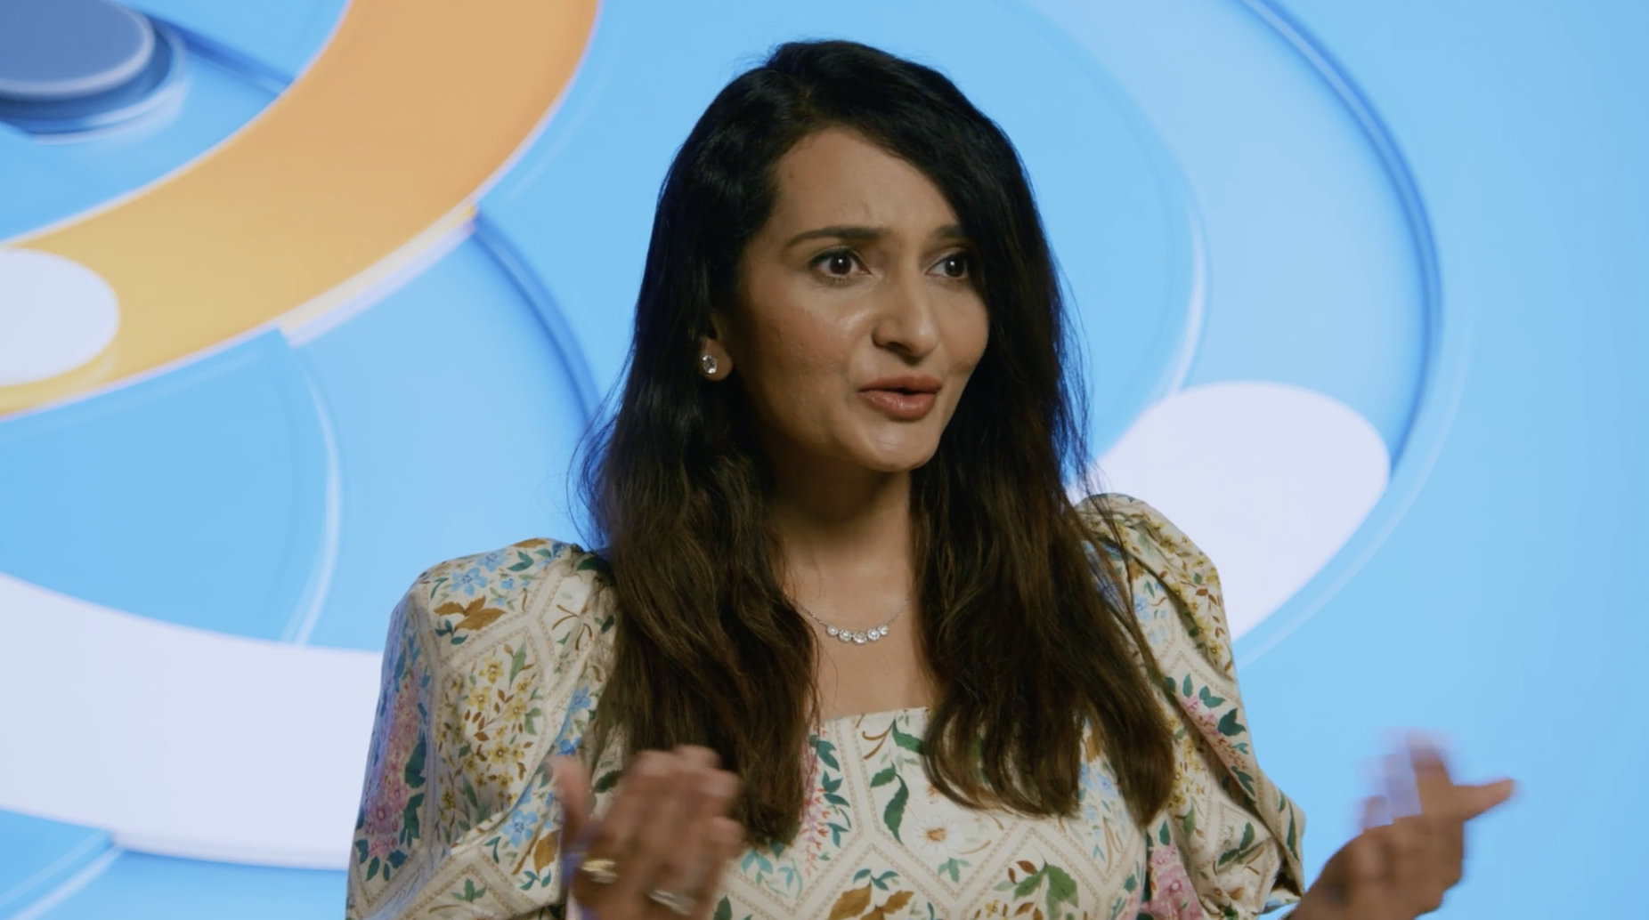
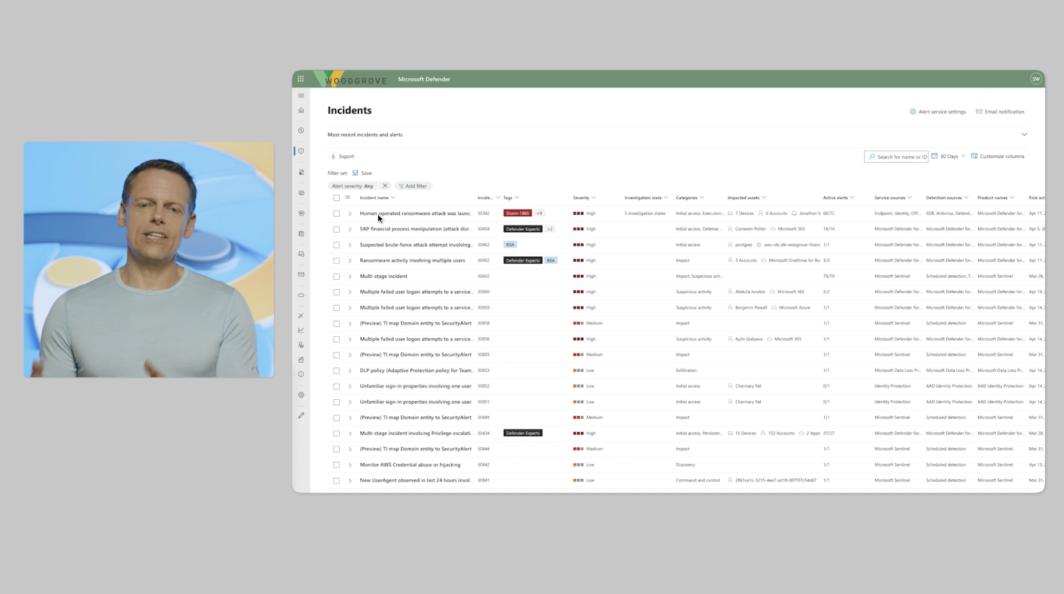
Webinar Demos and Testimonials
The Microsoft Security team wanted to showcase their innovative solutions to support organizations on their Zero Trust journey. They were planning a webinar to not only inform the public about their new launches but also to showcase demonstrate the products in action through live demos and customer testimonials.
Our Work
Offered on-site and hybrid recording solutions to accomplish the Microsoft Security team's goals
Provided high-quality full pre-production, production, and post-production support to bring the vision to life
Recorded and edited a demos and testimonials on-site.
Offered full webinar end-to-end support
Cut the webinar into two shorter sizzles to promote on-demand (edited to custom social sized videos)
The Result
Pre-event teasers shared on X and LinkedIn generated excitement, resulting in 3,591 webinar registrations
The client continues to drive traffic using on-demand access and engaging post-event highlight videos, keeping the momentum going beyond the live event

Slide 2
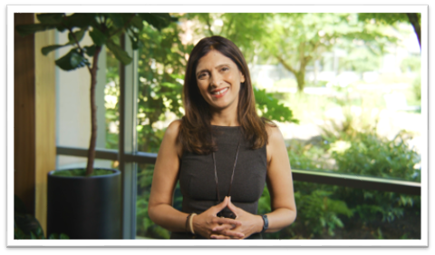
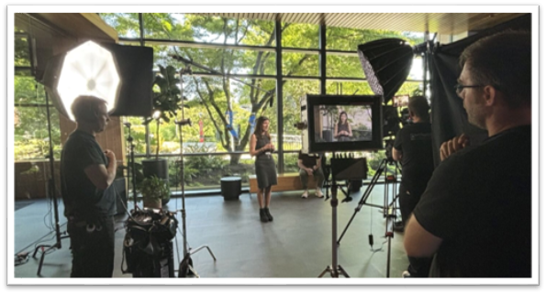
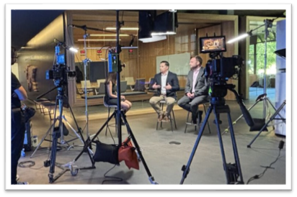
Elevated On-site Webinar Production
The Microsoft Security team wanted to showcase their innovative solutions to support organizations on their Zero Trust journey. They were planning a webinar to not only inform the public about their new launches but also to demonstrate the products in action through live demos and customer testimonials.
Our Work
Offered on-site and hybrid recording solutions to accomplish the Microsoft Security team's goals
Provided high-quality full pre-production, production, and post-production support to bring the vision to life
Recorded and edited a dynamic pre-event sizzle promoting the live event
Offered full webinar end-to-end support
Cut the webinar into two shorter sizzles to promote on-demand (edited to custom social sized videos)
The Result
Pre-event teasers shared on X and LinkedIn generated excitement, resulting in 3,591 webinar registrations
The client continues to drive traffic using on-demand access and engaging post-event highlight videos, keeping the momentum going beyond the live event

